Slide 1
Scheduling

Slide 2
Previous
Process
Lab
Getting started with hardware using C and assembly
Context switching at assembly level
Basic CMSIS-RTOS2 thread operations
Notes:
In the previous module we learnt about processes. We also did a lab exercise to perform CMSIS-RTOS2 basic thread operations.

Slide 3
Current Module
Levels of Scheduling
Scheduling Algorithms
Non-pre-emptive
Pre-emptive
Quantum Size
Priority
How to evaluate Performance
Real Time Scheduling
Aperiodic RT scheduling
Notes:
In this module, we will cover the various levels of scheduling of threads, scheduling algorithms which can be non-pre-emptive or pre-emptive. We will also describe Quantum size of thread, priority of thread and how to evaluate performance. Next, we will concentrate on Real Time Scheduling and aperiodic Real time scheduling.

Slide 4
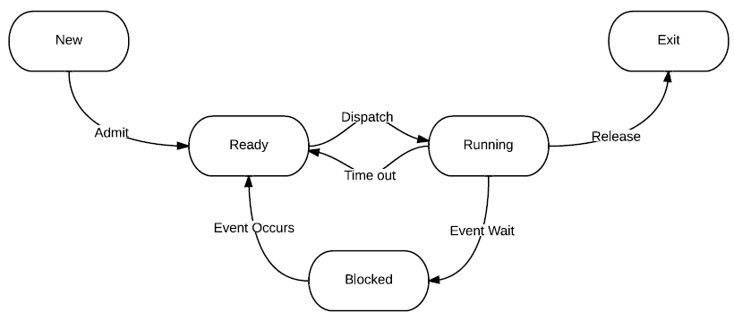
Thread State Model
handled by scheduler (osKernelStart() starts scheduling)
New to Ready – osThreadNew()
Running to Exit – osThreadTerminate()
Ready to Running – handled by scheduler (osKernelStart() starts scheduling)
Running to Ready – osThreadYield()
When and How - the job of the scheduler
To be practiced in lab session
Notes:
We saw in the last module that a process can have five states (New, Ready, Blocked, Running, Exit) and how the process is transitioned from one state to another due to triggers: Ready, event occurs, event wait, dispatch, time out, and release.

Slide 5
Levels of Scheduling
Long-term
Which processes to add to the ready queue
Historically the job of the operator
This scheduling level is unfrequently invoked compared to others
Establishes the degree of concurrency
Large scale computing systems
Medium-term
Available for OSs that support swapping
Decides which process to swap out or suspend.
Moves threads from the main memory to the secondary memory or vice versa
Uses the seven states model
Short-term
Which ready process(es) to dispatch next
Performs context switching
In this set of material, we will focus on the short-term scheduling. Whenever the term scheduling is used, unless otherwise specified, it refers to short-term scheduling.
Notes:
Scheduling can be classified as long term, medium term or short term depending on the time interval involved. Long term scheduling is normally by carried out by the operator, deciding to run which job at what time using a queue.
Medium term scheduling is by typically done by the operating system; the OS decides which thread or process to interrupt and run another process. It moves processes from secondary memory to primary memory and schedules it, and may move the interrupted process from primary memory to secondary memory. This uses the 7 states model for the Process.
Short term scheduling is a real time scheduler. Depending on the type of scheduling algorithm, it swaps processes after doing context switching.

Slide 6
What Makes a Good Scheduling Algorithm
Scheduling criteria
Utilisation: computing resources, I/O, network
Throughput: completions of processes per time unit
Turnaround: the time it takes from New to Exit
Response: less delay in the interaction with users
Deadline: soft or hard
Priority: some processes are more important than the others
Fairness: despite the existence of privilege
Predictability: less variation in the performance
A good scheduling algorithm is also application-specific
Notes:
A good scheduling algorithm satisfies various criteria like utilisation, throughput, turn around time, response time, meeting the dead line for process, priority of processes, fairness in scheduling processes, and predictability of scheduling of processes. A good scheduling algorithm will also depend on the application and the number and nature of the processes. Good scheduling considers utilisation of CPUs, I/O, memory, network etc. in a balanced way. The algorithm should help obtaining good throughput, i.e. maximum completed processes per unit time, furthermore, the algorithm should give shortest turn around time, i.e. time between taking a new process and exiting the process to schedule the next process. Also, it should provide a good response time i.e. less delay between user’s request and the service is provided to the user. The dead line of a process to complete depends on its nature, i.e. whether it is soft real time process or hard real time process. A soft real time process, need not meet the dead line for completion all the time. If it misses occasionally it is sufficient. Nothing drastic may happen if the dead line is missed a few times. But a hard real time process needs to meet the dead line for completion all the time. Otherwise there will be catastrophic effects (like brakes in automobile).

Slide 7
Behaviour Patterns of Processes
Processes can be
CPU bound - more CPU computations than I/O interactions
IO bound – more IO interactions than CPU computations
Dependency between processes
Understanding the nature of the processes helps designing an optimized scheduling algorithm
Notes:
Processes can be of two types: it can be CPU bound, i.e. need more CPU use for computations than I/O interactions or it can be I/O bound, i.e. need more IO operations than CPU computations. There can be dependencies between processes. By knowing the nature of the processes, we can design an optimized scheduling algorithm for processes.

Slide 8
Non-Preemptive Algorithms
Non-preemptive: a process keeps running until it voluntarily gives up or blocks.
Let’s consider the single-CPU case
First-come, first-served (FCFS)
Also known as first-in-first-out (FIFO)
Used for long-term scheduling by old batch systems
The ready queue needs to keep track of the thread order.
p_first = p_CB->p_lnk;
p_CB->p_lnk = p_first->p_lnk;
Not really suitable for interactive systems:
Poor responsiveness and fairness
Unpredictable
Tends to starve short I/O-bound processes
Convoy Effect
Could be used as a sub-component in the queue
Notes:
One of the types of algorithm used is a “Non-pre-emptive” algorithm. For this type, the process is allowed to run as long as it needs to till the end. A running process is never interrupted to switch to run another process and once the current process completes, the next process is allowed to run.
One algorithm that falls into this category is the first-come, first-serve algorithm (FCFS or FIFO). It follows the old batch processing concept. It is not suitable for interactive systems because of poor response and it is not fair to all processes. We can not predict when a process will be scheduled since it depends on the running time of the running process. This algorithm gives more time to CPU bound processes and some short I/O bound processes may be delayed for a long time or be starved for a long time. This algorithm could be used as a sub-component in a queue of sub processes.

Slide 9
Non-Preemptive Algorithms
Shortest job first (SJF)
Also known as shortest process next (SPN) or shortest job next (SJN)
Dispatches process with shortest execution time
To counteract the Convoy Effect, favours short processes
Minimizes the average waiting time
What if short processes keep coming?
Starves long processes
Also, how do you predict the execution time of the process?
Usually you can’t, you can estimate
Exponentially weighted averaging
Notes:
Another Non-Pre-emptive algorithm is “shortest job first” (SJF); it is also known as “shortest process next” (SPN). For this algorithm, the process that has the shortest execution time is scheduled first. Since these processes use the CPU for a relatively short time, the other processes get a chance to run. Hence, the average waiting time is reduced. But, if the shortest job arrives very often, then it will get a chance to run more often and the processes with longer execution time may not find a chance to run, leading to starvation for long processes. Predicting the execution time of a process is done via intelligent guessing or estimating or by doing exponential weighted averaging. Exponential weighted averaging is explained in the next slide.

Slide 10
Exponentially Weighted Averaging
You need to estimate the execution time of the process for some algorithms
An iterative approach:
t_{n}: measure the n^{th} execution time
e_{n}: the estimate n^{th} execution time
w: the exponential weight (0<w<1)
e_{n+1=} wt_{n} +(1-w)e_{n}
e_{n+1=} wt_{n} +(1-w)wt_{n-1}+(1-w)²wt_{n-2}+…(1-w)^{i}wt_{n-i}… +(1-w)^{n+1}e₀
To simplify the implementation, take only the most recent n history executions into account
Causes unpredictability
Notes:
An “exponential moving average (EMA)”, or “exponentially weighted moving average (EWMA)”, applies exponentially decreasing weighting factors. The execution times of the process are recorded. These values are summed with exponentially decreasing weights (mathematically averaged). By this action, the variations in the mean are aligned with the variations in the data.

Slide 11
Preemptive Algorithms
Preemptive: processes can be interrupted by either processes with a higher priority or the thread scheduler
Round-robin (RR)
A preemptive FCFS variant
Needs to keep track of time
Once a process runs out of its time slice (or quantum), put it to the end of the Ready queue and dispatch the head of the queue
The Ready queue: a circular FCFS queue
Starvation-free, time-sharing
However, the average waiting time is increased, also frequent context switching results in higher overheads
Notes:
Now we will consider the preemptive type of algorithms. Preemptive processes can be interrupted by either: processes with a higher priority or the thread scheduler. Round Robin is a commonly used example of a preemptive algorithm. You keep a “Ready” queue of processes to run. First process is allowed to run for a fixed amount of time, then it is preempted (i.e. stopped, do context switch). The stopped process is kept in the end of the queue. The next process at the head of the “Ready” queue is allowed to run for a fixed amount of time. This is repeated. The “Ready queue” can be considered as a circular FCFS queue. This algorithm allows all the processes to get a chance to run. There is no starvation. The concept is time sharing of the CPU for all processes. However, the average waiting time increases with the number of processes in the queue and the context switching for each process causes more overhead delay.

Slide 12
Quantum Size
How to pick the quantum size?
Large quantum size may starve small processes (degenerate to the FCFS)
Small quantum size introduces heavy context switching overhead
Choose the size based on the needs of interaction
How frequently does the user interact with the OS?
The quantum size should provide the OS with good responsiveness to the user input
Choose the size based on the performance (throughput)
Theoretical performance modelling, simulation
Practical experience
A rule of thumb: 80% of CPU bursts should be smaller than the quantum*.
*Abraham Silberschatz, Greg Gagne, and Peter Baer Galvin, "Operating System Concepts, Ninth Edition ", Chapter 6
Notes:
The round robin is a preemptive algorithm that gives each job a time slot or “quantum”. The scheduler forces the process out of the CPU after the allocated time expires.
For example, if the time slot is 10 milliseconds, and job1 is given 10 ms, then job 2 is given 10 ms and so on. If job 1 takes a total time of 25 ms to complete, the round-robin scheduler will preempt job 1 after 10 ms and give job 2, 3 etc. 10 ms each on the CPU. After all the jobs had their equal share (10 ms each), job1 will get another allocation of 10 ms CPU time and the cycle will repeat. This process continues until the job finishes and needs no more time on the CPU.
Job1 = Total time to complete 25 ms (quantum 10 ms).
First allocation = 10 ms.
Second allocation = 10 ms.
Third allocation = 10ms but job1 self-terminates after 5 ms.
Total CPU time of job1 = 25ms
Selection of quantum size (say 10 ms) is important. A large quantum size increases the waiting time to run for processes and it can starve small processes. Whereas if you have small quantum size, context switching will need to occur more often and it increases waiting due to overhead delay. We need to choose the Quantum size by checking how often the user (or process) interacts with the OS. The quantum size should provide good response times to the user’s input. The quantum size can be chosen by theoretical performance modelling and simulation or by experience. The rule of thumb is 80% of CPU bursts should be smaller than the quantum as this makes sure that the CPU bursts get executed fully, reducing the amount context switch.
Any program or process will have I/O burst and a CPU burst. Almost all processes alternate between two states: A CPU burst of performing calculations, and an I/O burst, waiting for data to transfer in or out of the system.
CPU bursts vary from process to process, and from program to program.
Reference http://www.cs.uic.edu/~jbell/CourseNotes/OperatingSystems/6_CPU_Scheduling.html

Slide 13
Preemptive Algorithms
Shortest Remaining Time First (SRT)
A preemptive SJF variant
Dispatch the process with shortest execution time once the current running process is finished or if any new thread with shorter execution time is ready
You need to estimate the execution time as well
Notes:
Shortest remaining time, or shortest remaining time first (SRTF), is a preemptive shortest-job-next scheduling. In this scheduling algorithm, the thread with the smallest remaining time to complete is executed. The currently executing process is the one with the shortest time remaining and it will run until they complete or a new thread with a shorter time remaining is added. Short processes are handled very quickly in this algorithm.
Like shortest job first, it can lead to some process starvation as long processes may not be scheduled if short processes are continually added.
Shortest job next scheduling and shortest remaining time scheduling are used only in specialized environments since we need to have good estimations of the runtime of all processes that are waiting to execute.
Reference: https://en.wikipedia.org/wiki/Shortest_remaining_time

Slide 14
How does priority help?
Is the shortest process always the most important?
On the contrary, usually trivial one
The user sets the importance of a process by assigning a priority to it
Can also use various types of scheduling algorithms
Static priority (remains unchanged throughout the lifecycle), dynamic priority(can be adjusted at runtime)
Examples:
Multiple queues with different priorities, within the queue you may use FCFS or RR
In RR, higher priority processes may have larger quantum
Notes:
Scheduling a process can be done based on variety of techniques. Scheduling a shortest process first may not be good since some of the shortest processes may not be the most important ones. We can assign priority to every process (Static Priority at the start of the system). The static priority for a process does not change with time, one can assign priority to a process during run time based on various reasons, this is called dynamic priority. Examples of dynamic priority are: Multiple queues with different priorities and within the queue use first-come, first-serve or round robin. Second example is, in the round robin scheme, higher priority processes may be given higher quantum time.

Slide 15
Preemptive Algorithms
Feedback: dynamic priorities
Most modern OSs use a variant of such algorithms
For multiple queues (presumably with different priorities), user can configure the following:
Number of queues
Which queue the process belongs to
When a process can be upgraded to a queue with a higher priority or downgraded to a queue with a lower priority
Scheduling algorithms for each queue
Scheduling algorithms for choosing a queue, e.g. a priority round-robin, 3 time slices for the highest, 2 time slices for normal and 1 for the lowest queue each round
Flexible and dynamic
Notes:
Most modern operating systems use scheduling with dynamic priorities that are preemptive algorithms. For example, the OS can have multiple queues with different priorities. The user can configure: Number of queues and which queue the process belongs to.
A process can be upgraded to a queue with a higher priority or downgraded to a queue with a lower priority and each queue can have their own scheduling algorithm.
There can be scheduling algorithms for choosing a queue, e.g. a priority round-robin, 3 time slices for the highest, 2 time slices for normal and 1 for the lowest queue each round.
The dynamic priorities provide flexibility in the scheduling of process.

Slide 16
A Feedback Example
Multiple RR queues
New processes join the queue with highest priority
Each time a process is preempted, it will be downgraded and join the end of the queue with the next lower priority (except the lowest queue)
Scheduler always dispatches the first process in the highest queue that is not empty.
Problems?
Starvation in lower queues.
Lower priority has longer quantum
Notes:
Another example of round robin scheduling with multiple queues is given here. There are multiple RR queues and each queue has different priority. Each time a process is preempted, it will be downgraded and join the end of the queue with the next lower priority (except the lowest queue). The scheduler always dispatches the first process in the highest queue that is not empty. This is a good dynamic scheduling technique. But, this may cause starvation of processes in the lower priority queues. One can assign a longer quantum for lower priority queues, but it may not solve the problem since the lower priority process can be interrupted by higher priority process.

Slide 17
A Practical Problem: How To Evaluate The Performance
Impossible to make definite comparisons in reality
Either theoretical analysis or some empirical measurements
Theoretical analysis – Queuing network, stochastic petri net, process algebra or other modelling tools
Empirical measurements – Simulation
Notes:
Evaluating the performance of any scheduling scheme is difficult. One can do theoretical analysis or do some empirical measurements by simulation. Theoretical analysis involves: queuing network, stochastic petri net, process algebra or other modelling tools.

Slide 18
Real-Time Scheduling
In a RTOS, meeting the deadline is more important than throughput and turn-around time
Deadline: the maximal computational time allowed
Needs special scheduling algorithms
Preemption is usually a standard in RTOS: otherwise scheduler will have to be idle from time to time in case it misses threads with earlier deadlines that arrive late.
Two basic categories: aperiodic and periodic
Also involves the priority and concurrency problems
Here we look at simple aperiodic cases first
All the plots in the following sections ignore the context switching time
Notes:
In RTOS, real time operating system, meeting the dead line for each important process is essential. Meeting the deadline is more important than the number of processes completed per second or throughput. RTOS uses mostly preemptive scheduling algorithms. Preemption is needed to make sure that threads that arrive late are able to meet their deadline. There are two types of threads: Periodic and aperiodic (non–periodic). threads have priority, i.e. some threads are more important or critical and hence have higher priority. Concurrency of systems means that several threads are executing simultaneously, (or time shared manner) and potentially interacting with each other. In the next set of slides we look at aperiodic threads. We ignore the context switching time in the plots for an easier understanding.

Slide 19
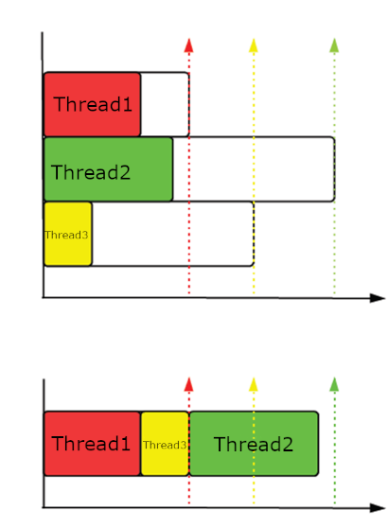
Aperiodic Real-Time Scheduling
Earliest Due Date (EDD)
All threads arrive at the same time
Known deadline and execution time for all threads
Start the thread with the earliest due date
Non-preemptive
Sorting algorithms
Optimal
Notes:
Let us consider an example for “aperiodic real time non-preemptive scheduling when all threads arrive at the same time.” Each thread’s deadline and execution time are known. In the plot, there are threads (red, green, and yellow). The execution time and deadline are shown in the first plot. Since the red thread (thread1) has an early deadline, schedule it first. No pre-emption is allowed. Then schedule the yellow (thread 3) since its deadline is approaching. Then, finally, schedule the Green thread (thread 2) whose deadline is approaching. This example is chosen so that all the threads are schedulable before the deadline with non-preemption.

Slide 20
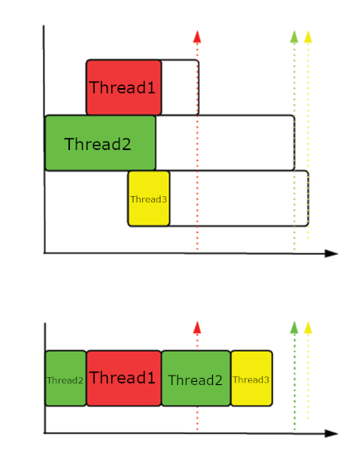
Aperiodic Real-Time Scheduling
Earliest Deadline First (EDF)
Different arrival times
Known deadline and execution time for all threads
Start the thread with earliest deadline
Preemptive (so overhead!)
Sorting algorithms
Optimal with respect to minimizing maximum lateness
Notes:
Now consider another example of “aperiodic real time preemptive scheduling of the threads arriving at different times with EDF”, earliest deadline first algorithm. Since it is preemptive, the process with the earliest deadline, can interrupt any running process. Assume that there are 3 threads arriving at different times with execution times as shown in the top plot. First schedule thread 2. Then, when thread 1 arrives, we find that thread 1 has an earlier deadline, hence preempt thread 2 and schedule thread 1. After thread 1 started, thread 3 arrives. But thread 3’s deadline is not near, hence thread 1 is allowed to run to completion. At the end of thread 1, we need to decide which thread to run, thread 2 or thread 3. Since thread 2 has an earlier deadline, we run thread 2 to completion. After the end of thread 2, we finally run thread 3. This is an example of a sorting algorithm. This technique minimizes maximum lateness.

Slide 21
Aperiodic Real-Time Scheduling
Least Laxity (LL)
Different arrival times
Laxity/slack: time to deadline minus (remaining) execution time
Known deadline and execution time for all threads
Start the thread with least laxity
Preemptive (more frequent)
Sorting algorithms
Dynamic priority: if not dispatched, then the priority will be raised; if it is executing, the priority maintains
Notes:
Least Laxity (LL) is an aperiodic real time scheduling algorithm which is preemptive with dynamic priority and threads arriving at different times. The laxity for the process is time to the dead line after the process arrives minus execution time. If the processor arrives later, its lax time reduces. The process with the shortest laxity time will be executed.

Slide 22
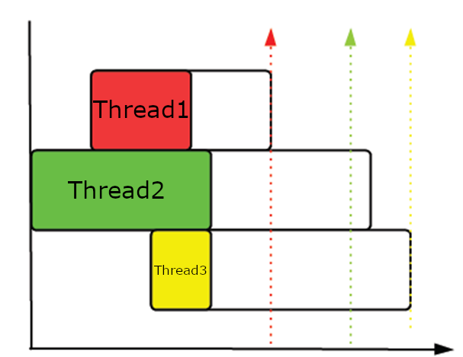
Aperiodic Real-Time Scheduling
An Example
thread | Starting at | Execution Time | Deadline
1 | 3 | 5 | 12
2 | 0 | 9 | 16
3 | 6 | 3 | 19
Notes:
Here is an example with three threads with their starting time (arrival time), execution time and deadline.

Slide 23
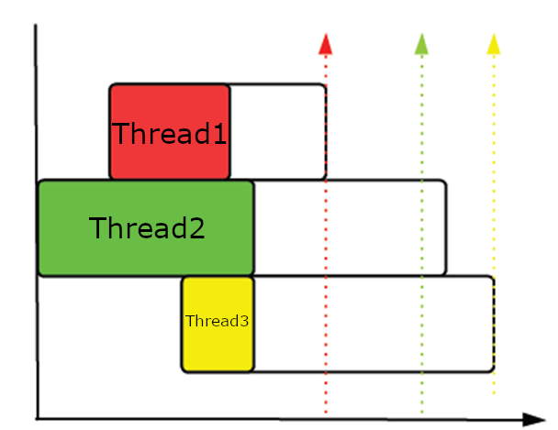
Aperiodic Real-Time Scheduling
Try to fill in the laxity at each time step, dispatch the least
 | 0 | 1 | 2 | 3 | 4 | 5 | 6 | 7 | 8 | 9
1 | - | - | - | 4
2 | 7 | 7 | 7 | 7
3 | - | - | - | -
 | 10 | 11 | 12 | 13 | 14 | 15 | 16 | 17 | 18 | 19
1
2
3
Notes:
Laxity values are shown for the threads as they arrive.

Slide 24
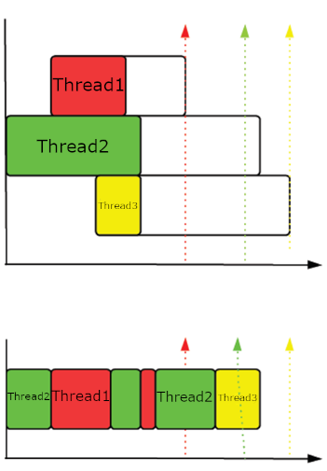
Aperiodic Real-Time Scheduling
Underscore indicates the least laxity process
Notice that at time step 7 and time step 9, preemptions happen due to change of priority (laxity)
 | 0 | 1 | 2 | 3 | 4 | 5 | 6 | 7 | 8 | 9
1 | - | - | - | 4 | 4 | 4 | 4 | 4 | 3 | 2
2 | 7 | 7 | 7 | 7 | 6 | 5 | 4 | 3 | 3 | 3
3 | - | - | - | - | - | - | 10 | 9 | 8 | 7
 | 10 | 11 | 12 | 13 | 14 | 15 | 16 | 17 | 18 | 19
1 | - | - | - | - | - | - | - | - | - | -
2 | 2 | 2 | 2 | 2 | - | - | - | - | - | -
3 | 6 | 5 | 4 | 3 | 2 | 2 | 2 | - | - | -
Notes:
At each time unit, the laxity value of the thread is written in the table. The thread with the least lax time is allowed to run. At time unit 3, thread 1 has the lowest laxity number and it is started. At time unit 9, thread 1 has the lowest laxity and hence it preempts thread 2 and starts executing. At time unit 10, thread 2 has lowest laxity and it starts executing. At time unit 14, thread 2 has completed and thread 3 starts running.

Slide 25
All that we have discussed so far…
All of the above is based on an ideal condition where:
Context switching time ignored
Single CPU: scheduling on multi-core is more challenging
“Well-behaved” processes
No dependency between processes
No periodic processes
Be aware of the real world…
Notes:
In all the previous examples, we ignored context switching time during preemption. We assume that it runs on a single CPU. We assumed that we know the execution time (with no jitter) for the threads. We also assumed that the processes are not periodic and the process do not depend or communicate with each other. In the real world these assumptions need to be relaxed.

Slide 26
Next
Assignment
Quantitative analysis and comparisons of various schedulers
Concurrency
Notes:
Next, we will look at quantitative analysis and comparison of schedulers.

